Slide 1
Predicting Austin House Prices
Spring Board Data Science Project
January 2022

Slide 2
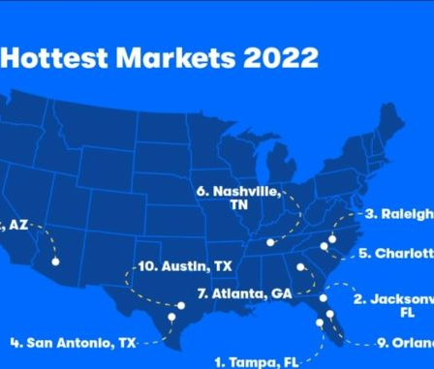
The Problem
Austin-10th hottest real estate market in the U.S and second most expensive real estate market in Texas
Austin house prices-10percent higher than fair market prices
What factors affect Austin House Sale prices?
Which deals can be considered good or bad?

Slide 3
Who might care?
Home buyers
Home sellers
Lending Companies

Slide 4
What factors might affect house prices?
Location of homes
Amenities and facilities available at each home
Year built
School characteristics in the neighborhood
School rating
Data Source-Zillow database

Slide 5
Data information
Period: January 2018 to January2021
Initial dataset:15171 rows and 47 columns
Excluded all other than single family homes
Final dataset:13703 rows and 47 columns

Slide 6
Data Wrangling
No missing values
No duplicate values
Included only single family types
Outlier detection and removal
Conversion of non numerical to numerical variables

Slide 7
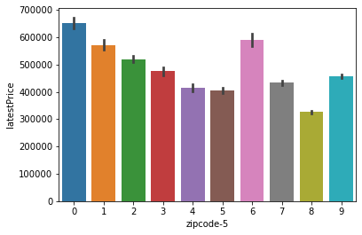
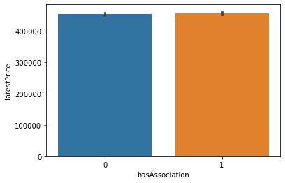
Feature Engineering and Exploratory Data Analysis
Location as represented by zipcodes found to have significant effect on price
“Has Association” no effect on price

Slide 8
Modeling
Target variable=Latest Home Price
30 features in the final model
Linear regression(baseline model),Support Vector Regression and Decision Tree Regression
Linear Regression-90.5 percent score on train data, 52.3 percent score on test data
Support Vector Regression-0.5percent on train data and -0.3 percent on train data
Decision tree regression-99.9percent on train data and 45.3 percent on test data
Hypertuned decision tree model- 77.1 percent on train data and 68.8 percent on test data

Slide 9
Model Comparison
Error Metrics
Final model-Hyper tuned decision tree model based on the scores and error metrics

Slide 10
Conclusion and Future Research
Most important features- Living area in square feet, location of the house represented by zip code and the lot size in square feet
Least important features- House view, number of water front features, heating facilities, number of primary schools middle schools in the location
Able to identify good deals and bad deals based on the model
Possibility of including boosting and bagging models for improving model performance
Reduction of features using principal component analysis for improved model performance

